Slide 1
Academic Management system
G-59
AKSHAY ANSHUL - IIB2019015
GAURAV YADAV -IIB2019022
PRITIK SHRIVASTAVA -IIT20190192
ADITYA RAJ - IIB2019023

Slide 2
Contents
● Introduction
●Existing System and Comparison
●Project Scope
●Challenges
●Software Tools Technologies
●Work distribution
●Snap Shots
●Traceability matrix

Slide 3
Introduction
Now a days online service is a best competitive edge for any organization which makes it differ from other organizations.
The AMS(LIMBO) is web based application which provides best platform for ease of the access to the administrative ,academics and non academics staff.
The focus of this project is to provide ease to the student as well as administrative department to work in a well organised and planned manner. Because it provides user friendly environment.
In this system the respective admins have their respective accounts with proper identification.The main goal of the application is to automate the process carried out in the organization with improved performance and realize the vision of complete paperless vision.

Slide 4
Project Scope
We described what features are in the scope of the software :
a.Course management for students.
b.Transparency in course registration and profile updation
c.Efficiency in communication between different departments
d.Proper conduction of examination.
e.Moreover storing and retrieving of the information is easy, so work can be done speedily as well as in lesser time.
f.It reduces the manpower needed to perform the administrative task by reducing the paper work needed.
g.It removes data redundancy and will be fast in operation.

Slide 5
Challenges
1
2
4
3
Lack of efficient communication
No prior knowledge of Backend
Selecting right procedures so that we can get results proper and
accurate.
Integration of all screens properly so that the app does not crash.

Slide 6
Existing System and Comparison:
Existing System | Proposed System
●Limited to use and login of only students ●Inefficient and slow ●Improper course management ●Irregularities in schedule management and exam conduction | ●Available to more personnel ●Fast and efficient ●Proper course management ●Consistency in schedule management and announcements.

Slide 7

Software tools and techniques
●FRONT END : HTML, CSS
●DATABASE : SQLITE
●WEB SERVER : GUNICORN
●DEVELOPMENT ENV : CONDA
●BACK END : DJANGO
●MEMORY : 32 MB HARD DRIVE and 128 MB RAM

Slide 8

WORK DISTRIBUTION:
PRITIK SHRIVASTAVA(IIT2019192):
a-) Backend , Handling databases
GAURAV YADAV(IIB2019022):
a-)Integrating frontend and backend
AKSHAY ANSHUL(IIB2019015)
a-)Backend ,test plan,traceability
ADITYA RAJ (IIB2019023)
a-) Frontend,test plan,traceability

Slide 9
Use Case Implemented
DECORATIVE ELEMENTS
DROP SHADOW
BASE LINE
SWASH

Slide 10
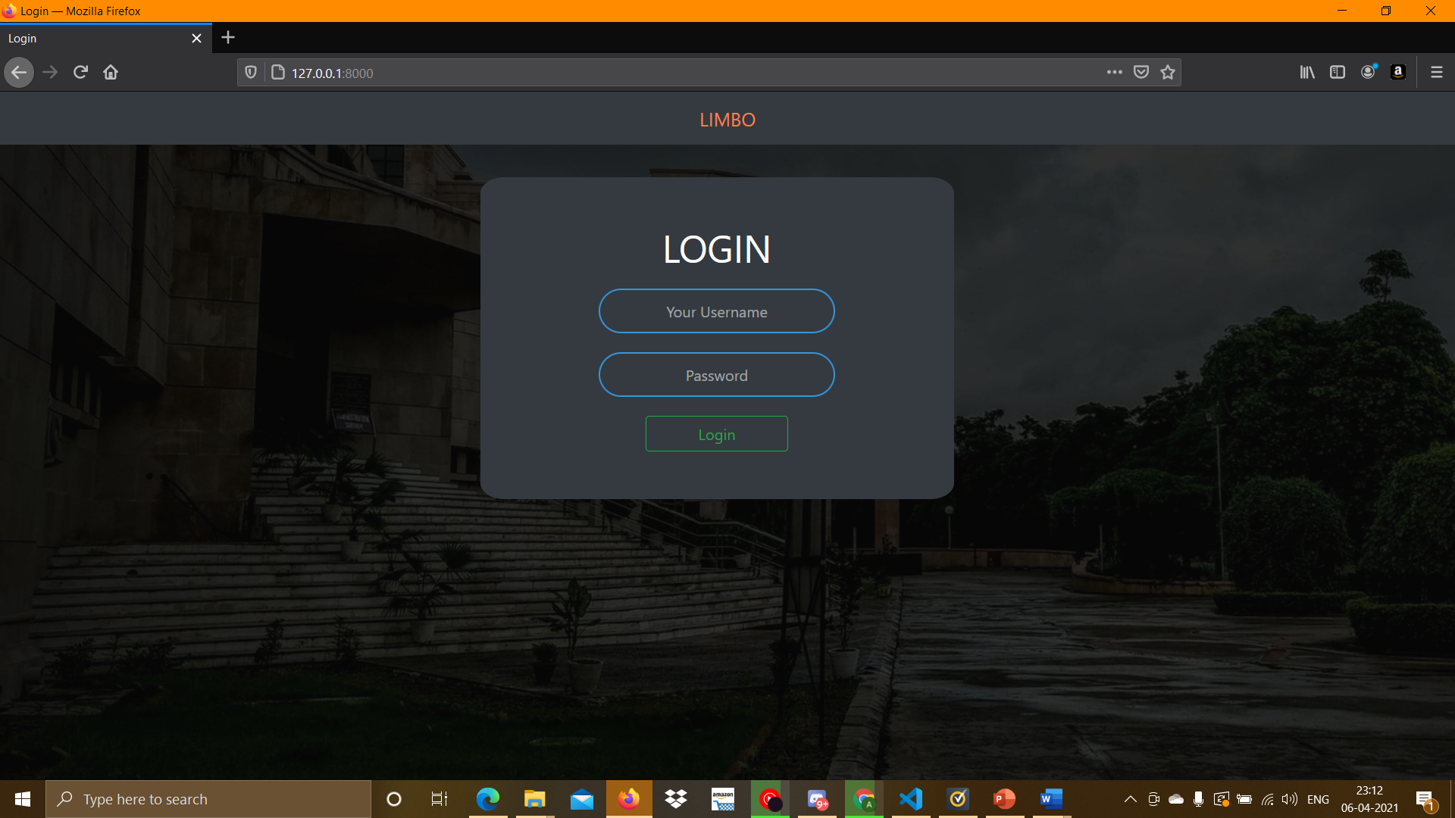
LOG IN PAGE:

Slide 11
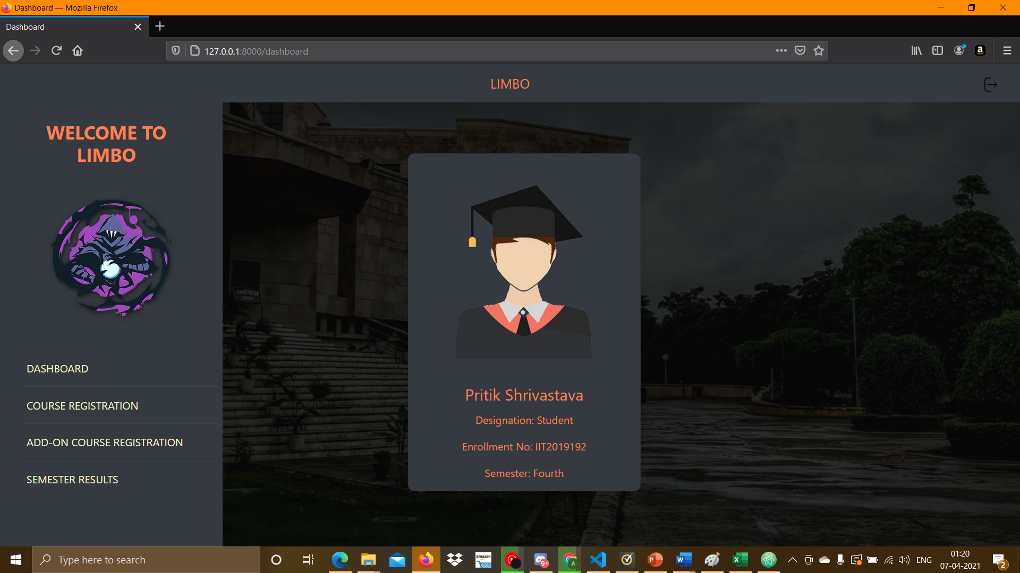
STUDENT DASHBOARD:

Slide 12
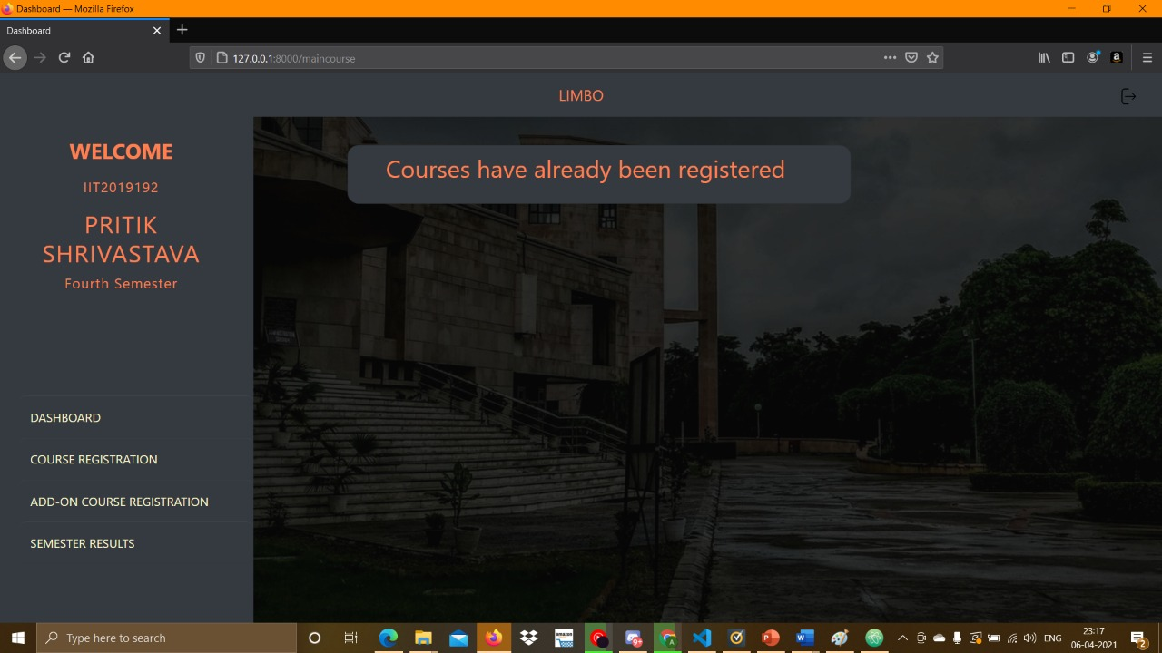
COURSE REGISTRATION:

Slide 13
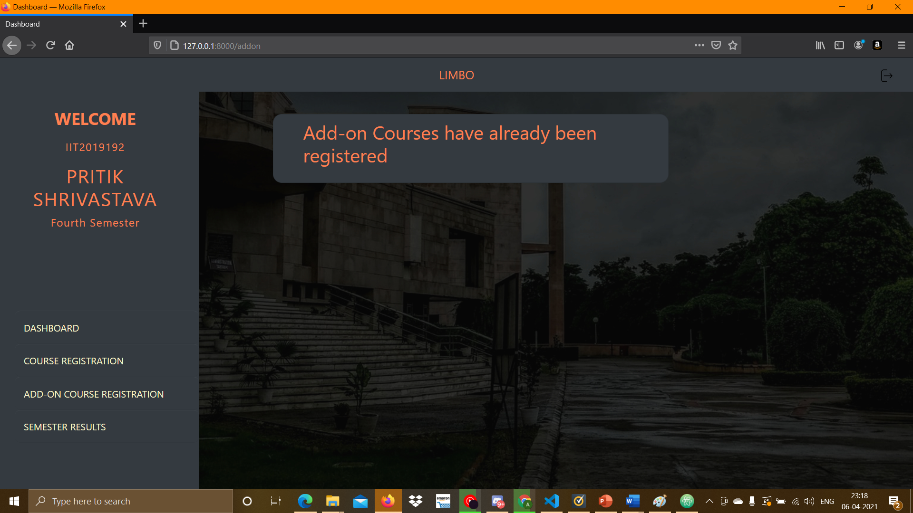
ADD ON REGISTRATION:

Slide 14
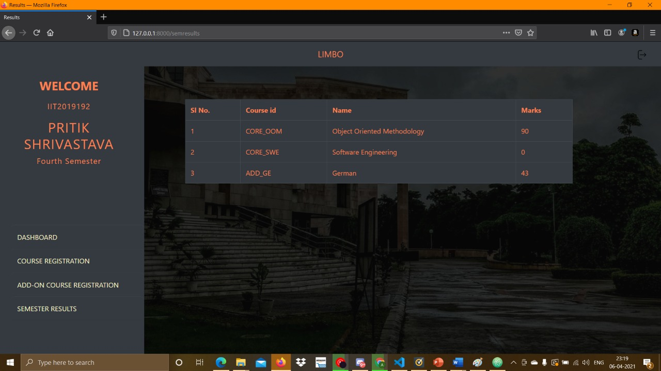
SEMESTER RESULTS:

Slide 15
FACULTY LOGIN:

Slide 16
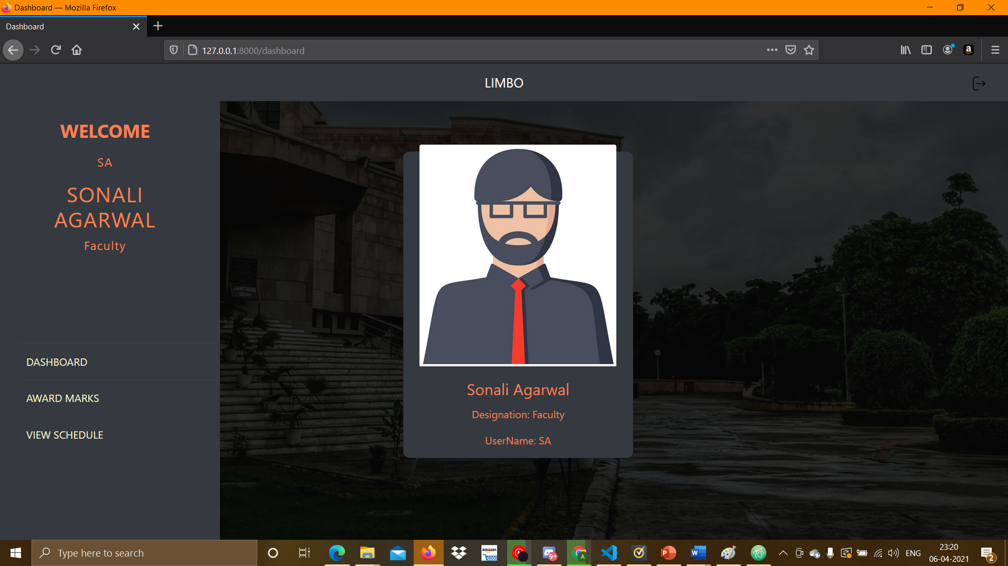
FACULTY DASHBOARD:

Slide 17
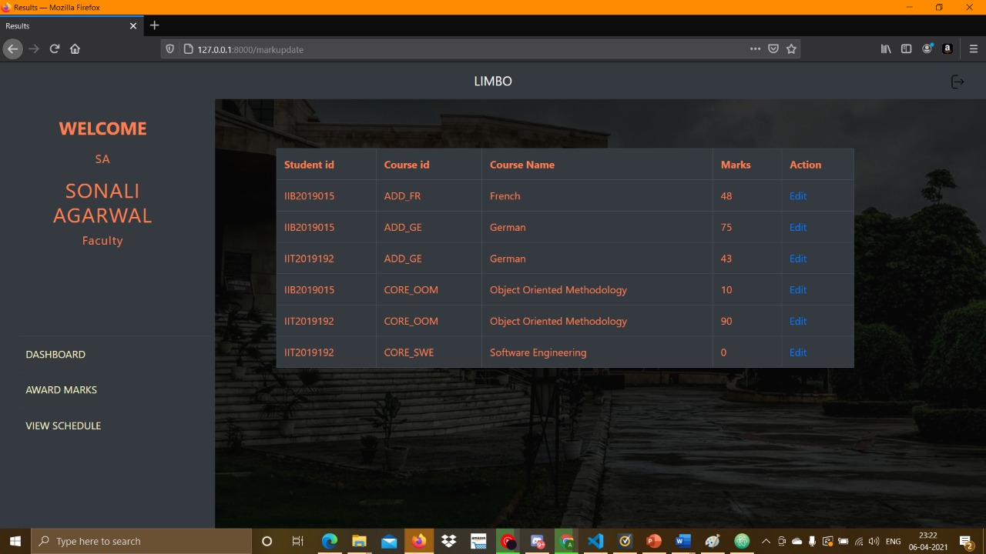
AWARD MARKS

Slide 18
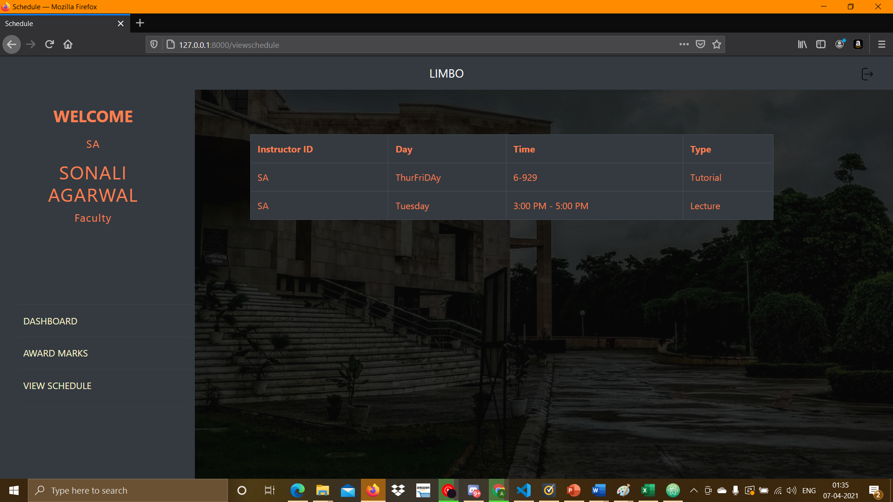
VIEW SCHEDULE:

Slide 19
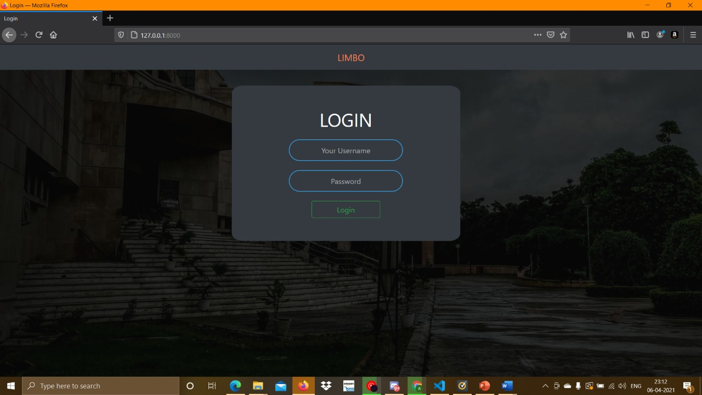
WARDEN LOGIN:

Slide 20
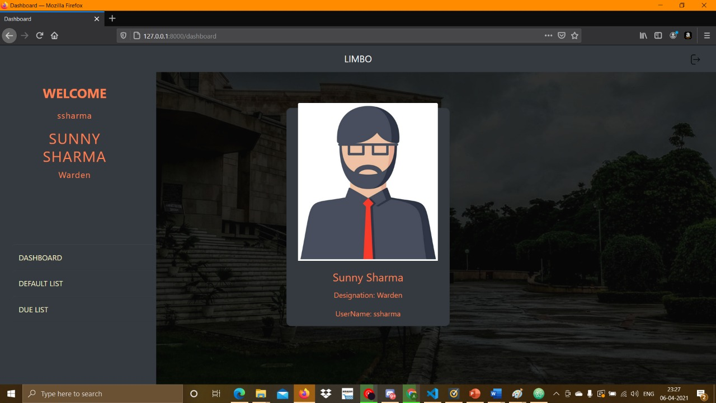
WARDEN DASHBOARD:

Slide 21
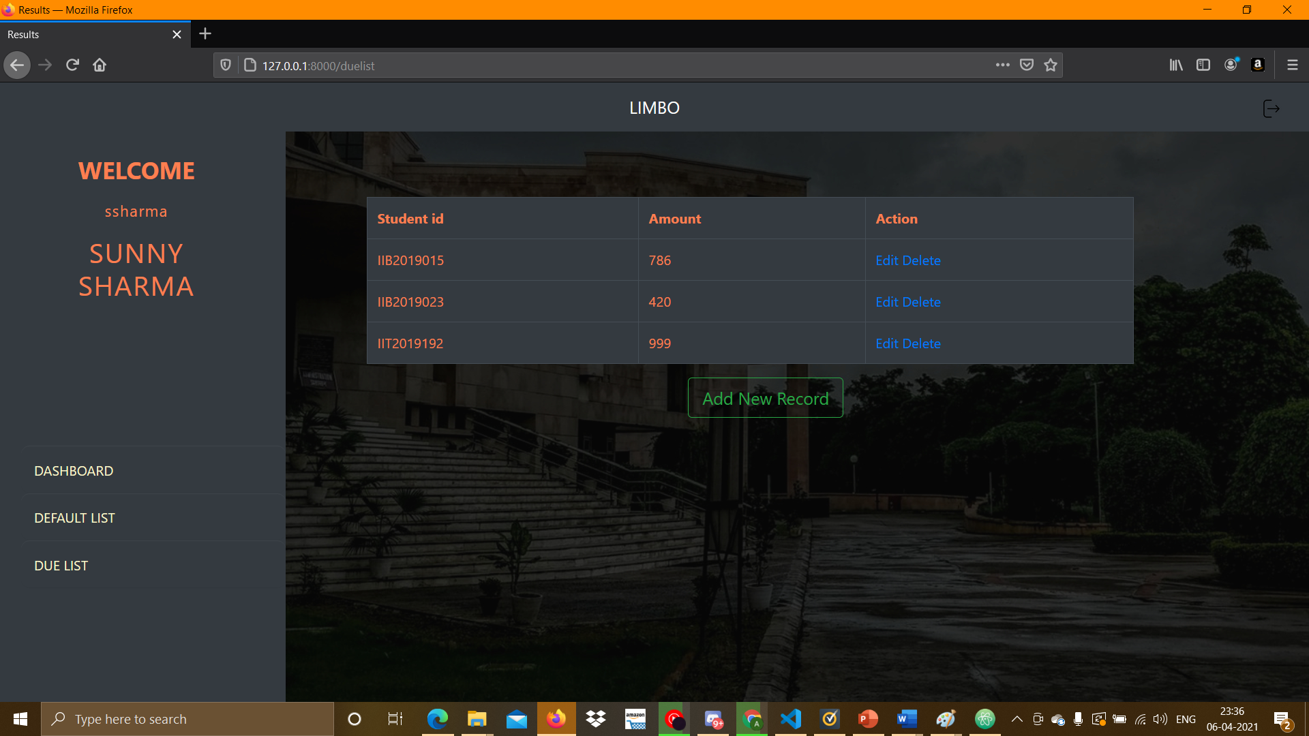
DEFAULT LIST:

Slide 22
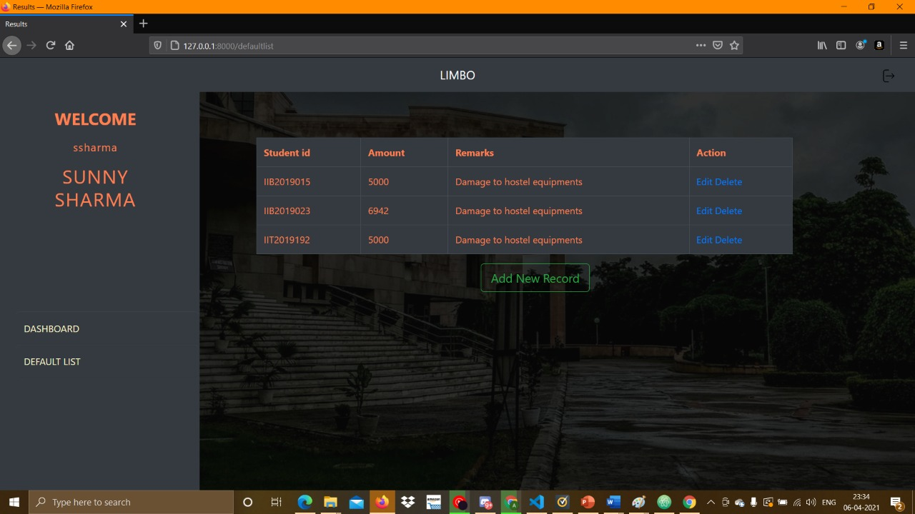
Edit/Delete Default List

Slide 23
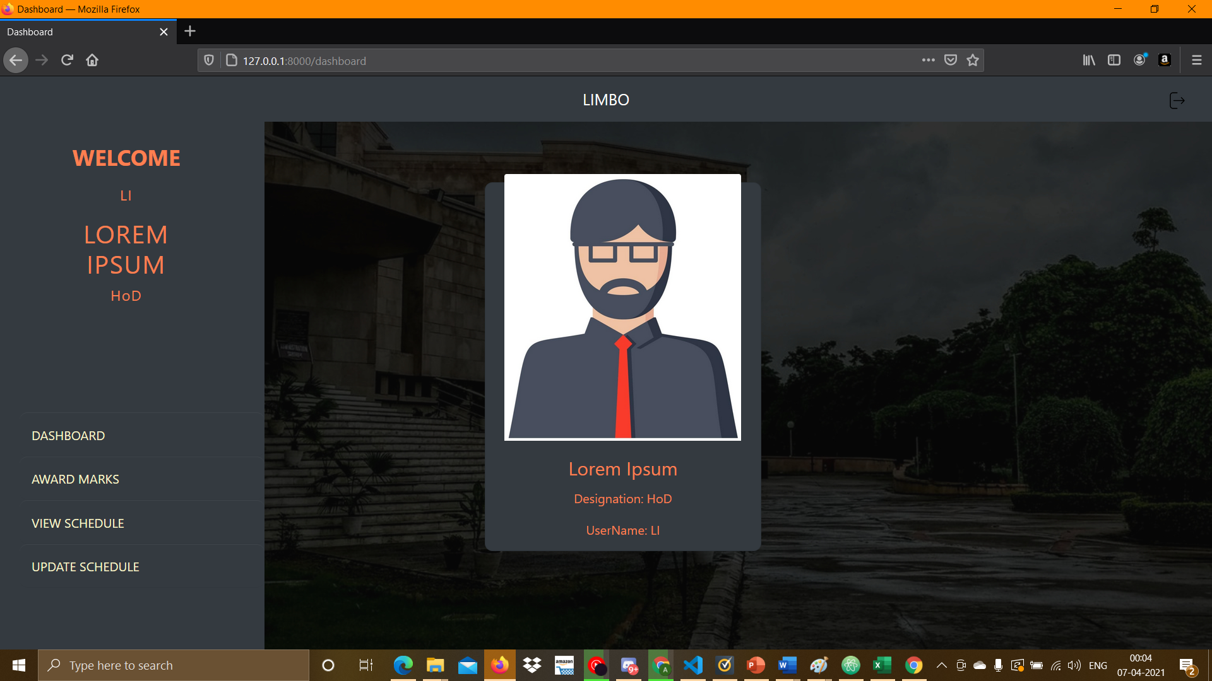
ACADEMIC STAFF LOGIN

Slide 24
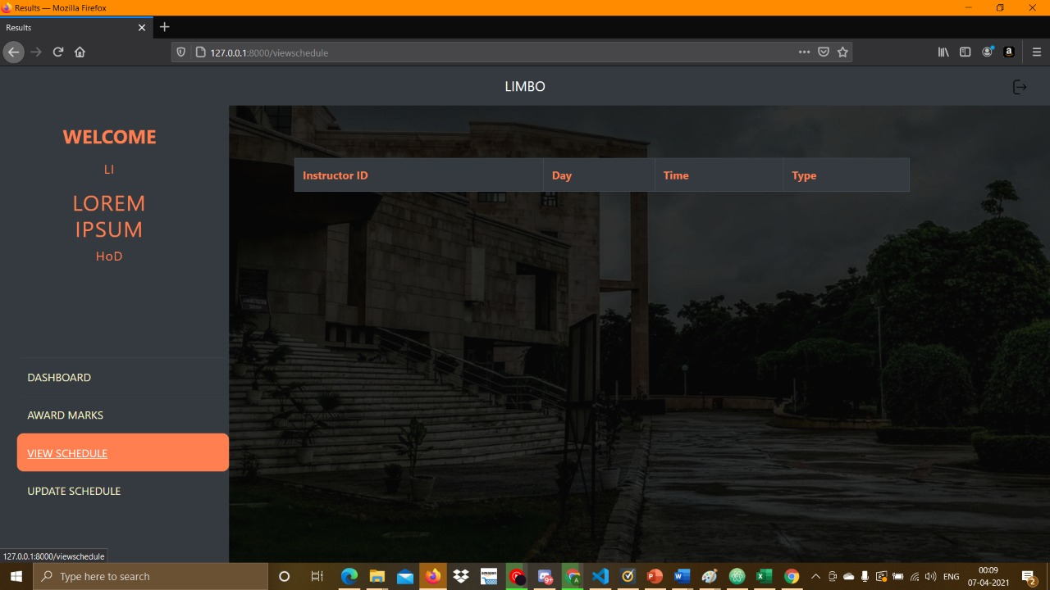
Viewing/Editing faculty Schedule

Slide 25
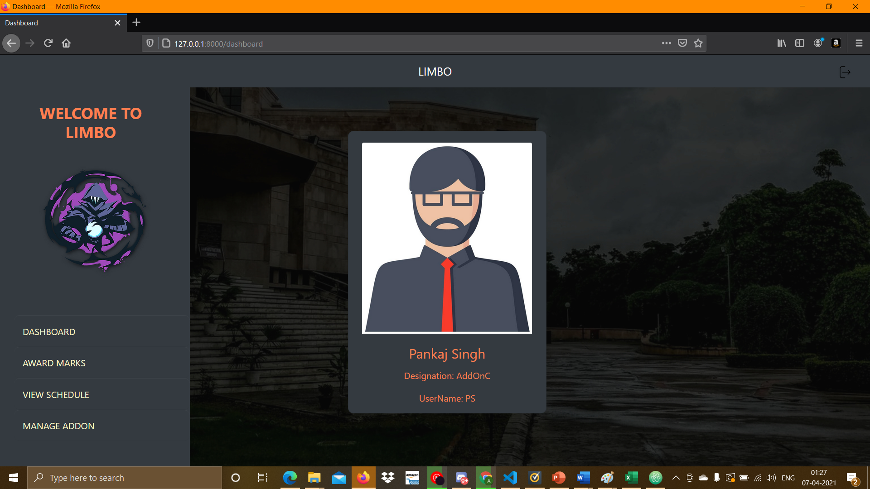
ADD ON COORDINATOR LOG IN

Slide 26
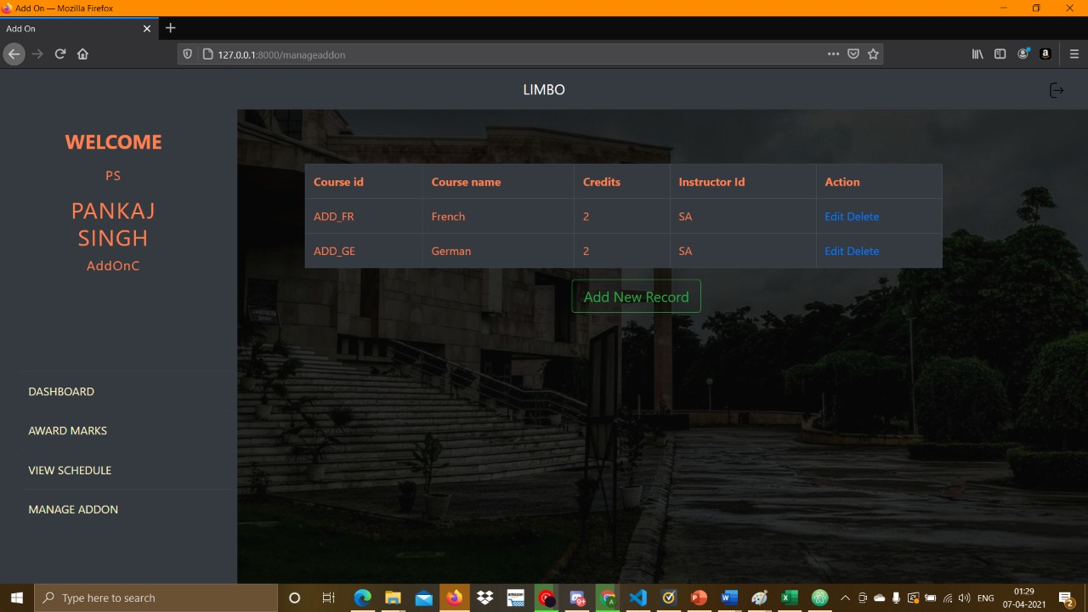
ADD-ON MANAGEMENT

Slide 27
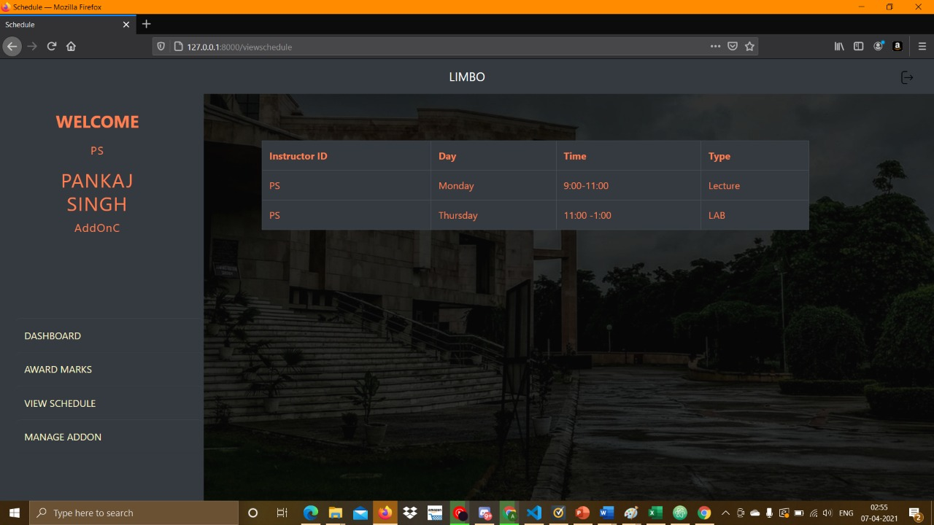
View Add-on Coordinator schedule

Slide 28
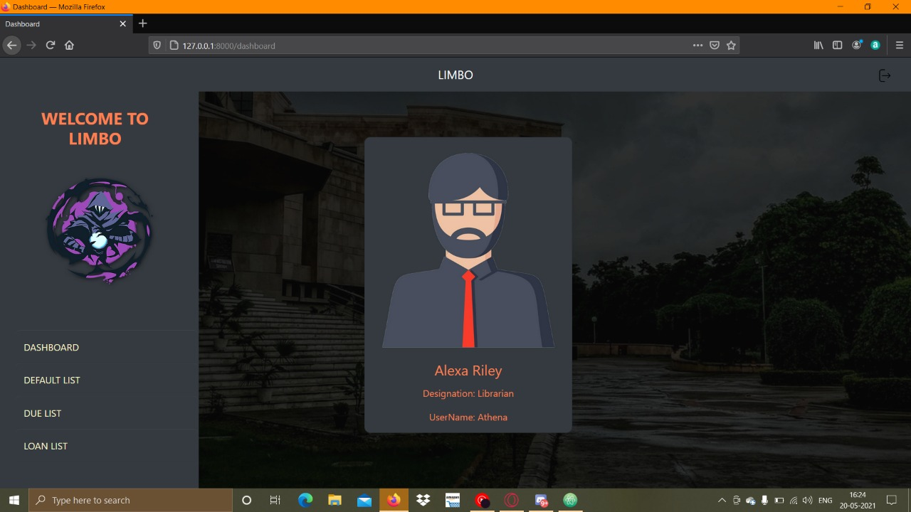
Librarian Login

Slide 29
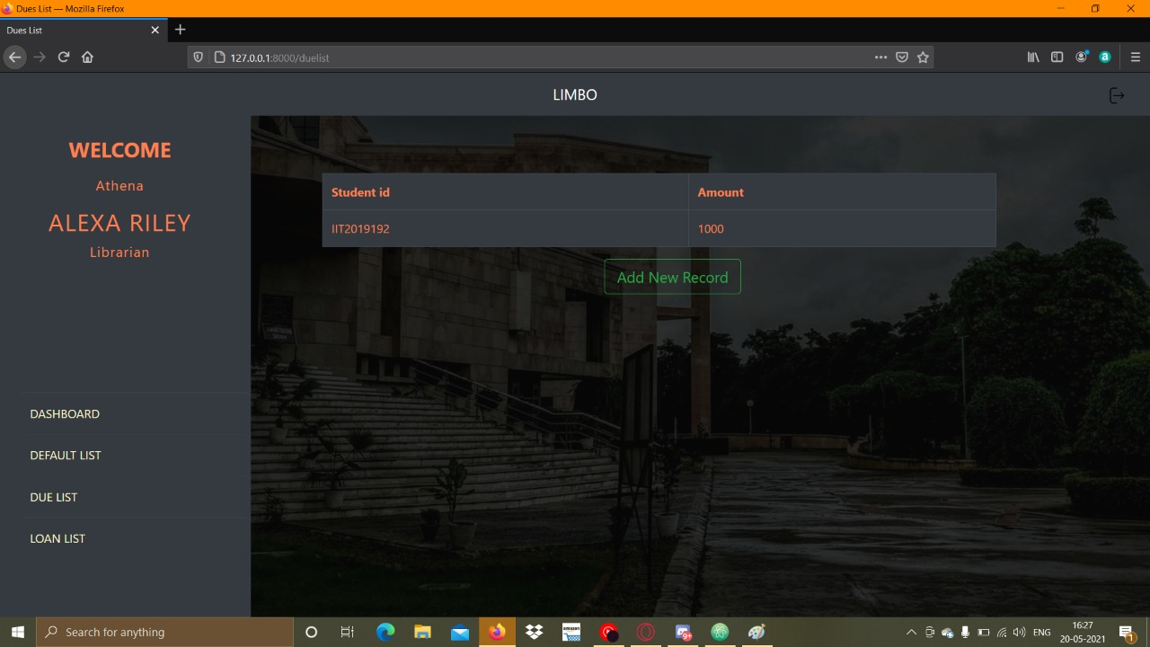
Librarian Default list

Slide 30
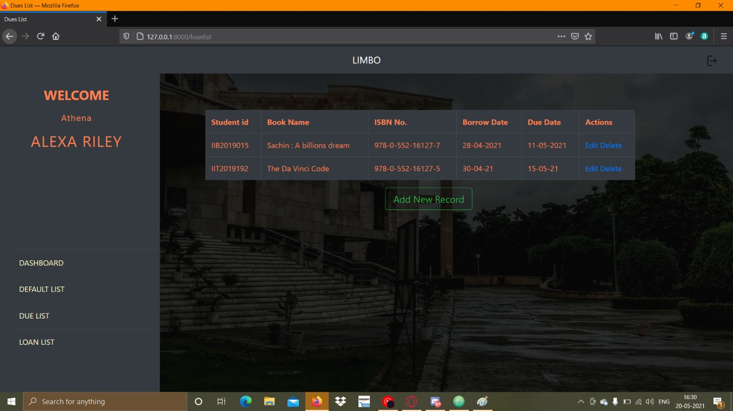
Librarian Loan List

Slide 31
Librarian Due List

Slide 32
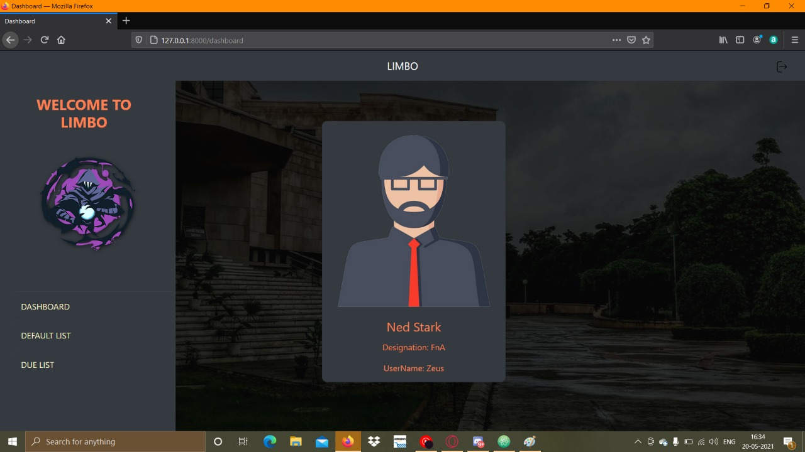
FnA Dashboard

Slide 33
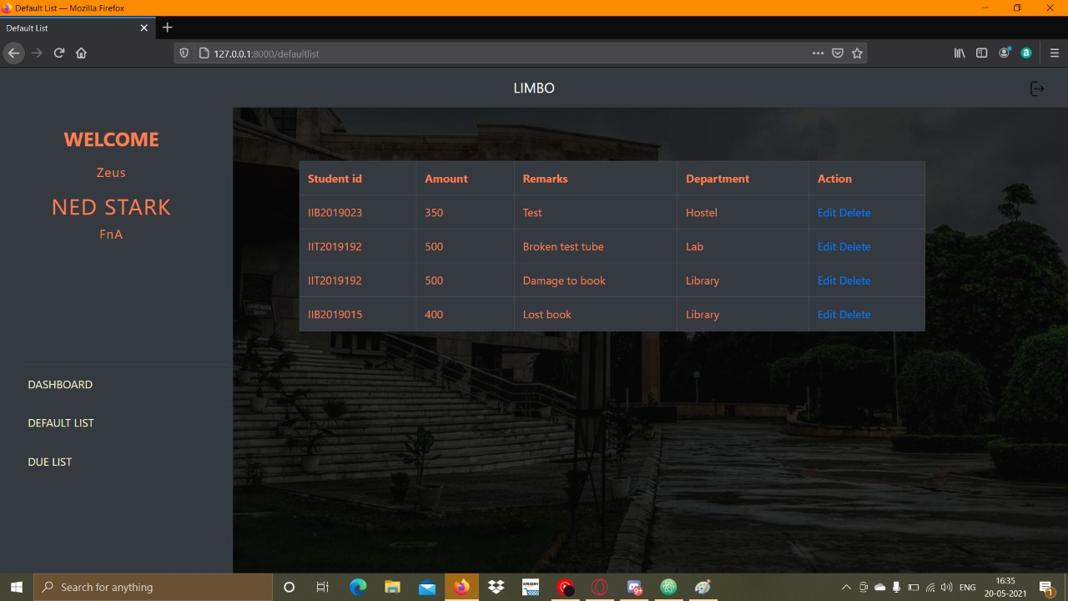
FnA Default List

Slide 34
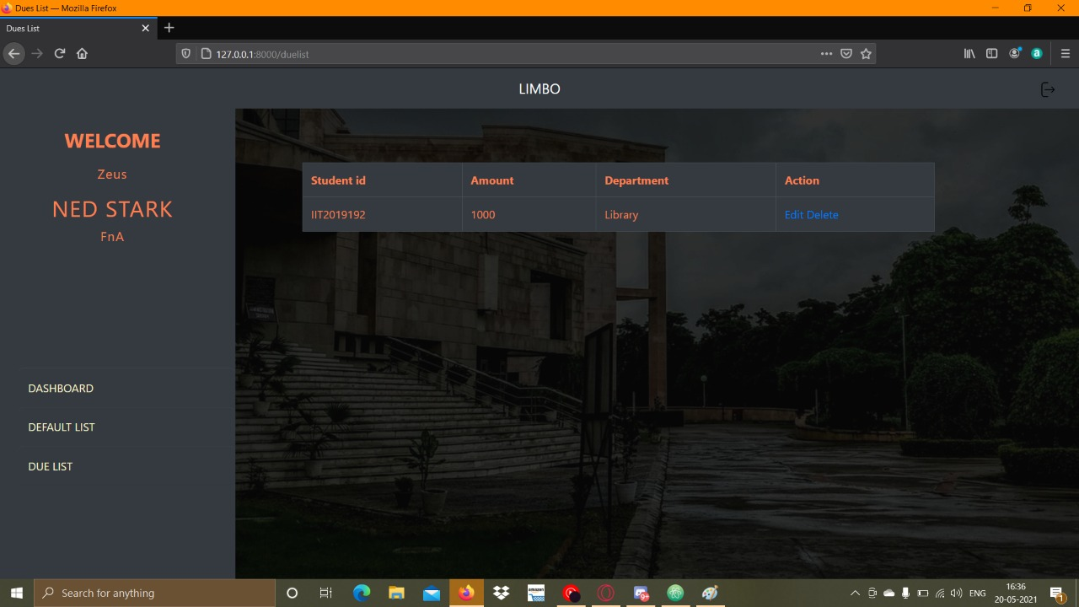
FnA Dues List

Slide 35

Gymkhana Dashboard

Slide 36
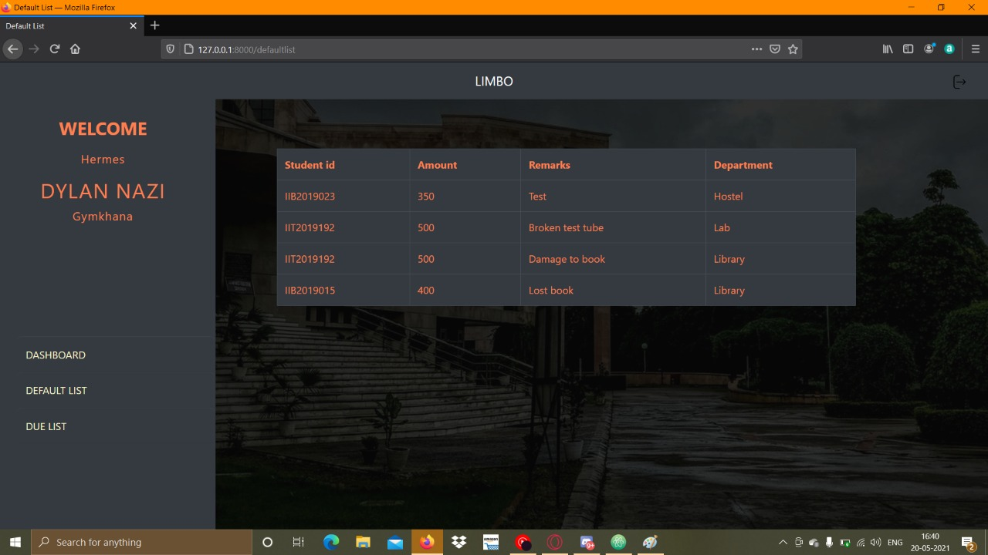
Gymkhana Default List

Slide 37

Gymkhana Dues List

Slide 38
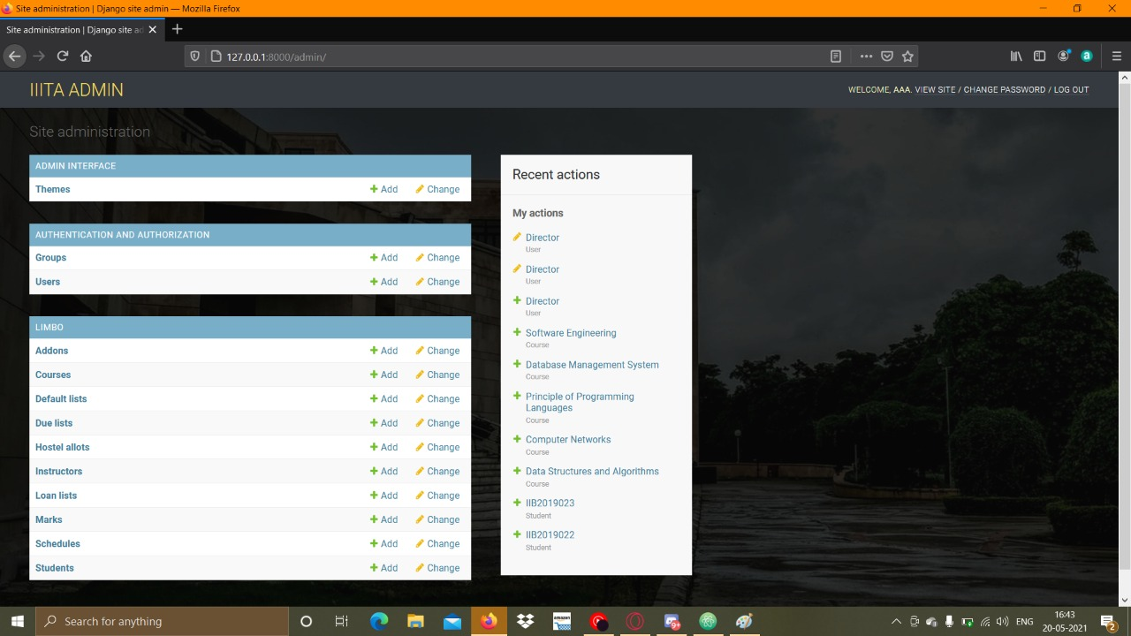
AAA manage students/courses

Slide 39
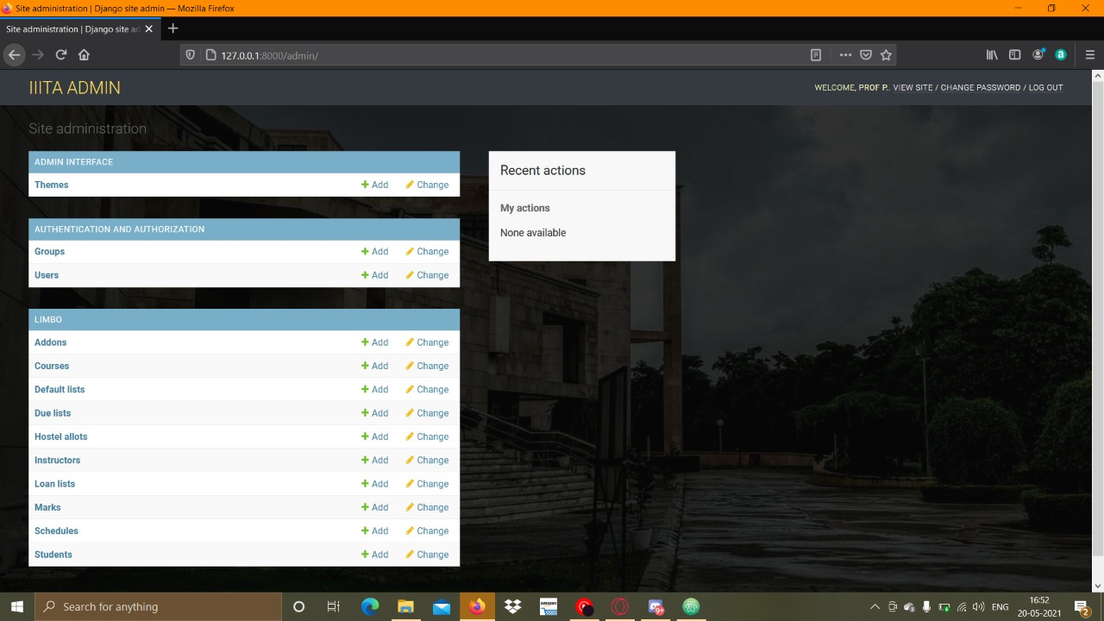
Director Dashboard

Slide 40

Dean Dashboard

Slide 41

Registrar Dashboard

Slide 42
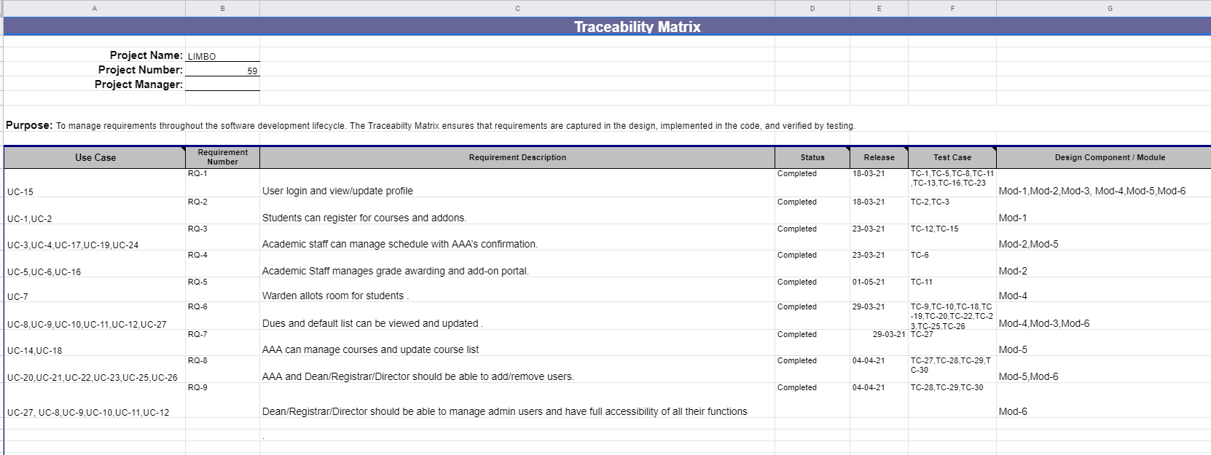
TRACEABILITY MATRIX:

Slide 43
Thanks!!
TOP LINE
DIFFERENT ORNAMENTS

